Slide 1
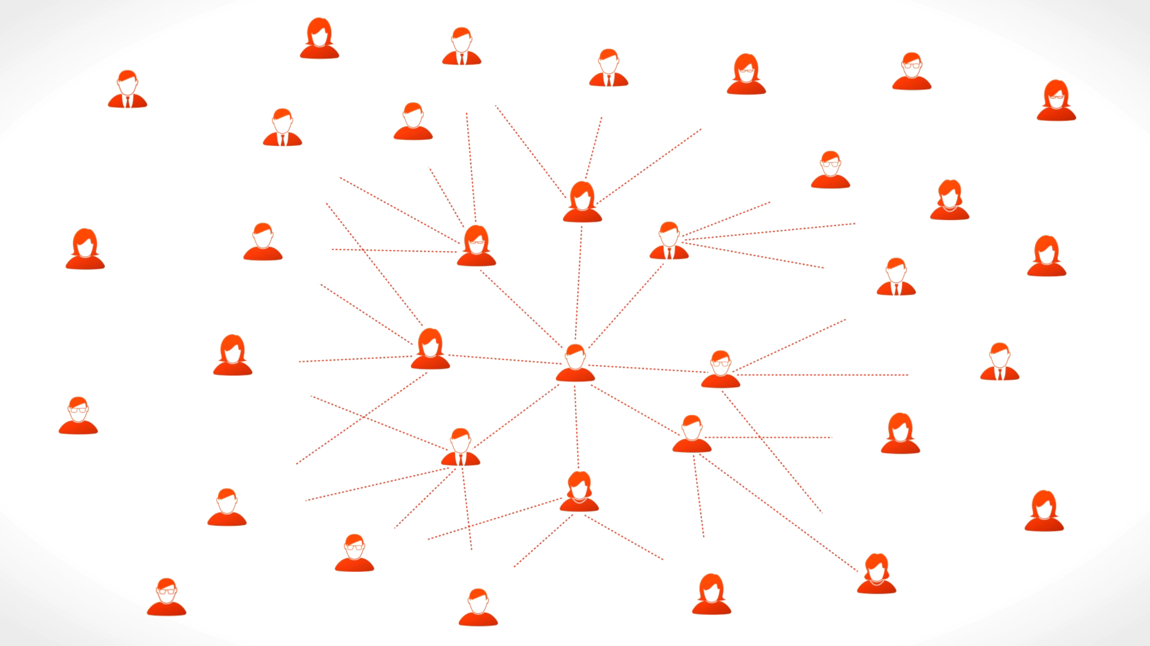
Training Social network
Lindokuhle Tami 219005173

Slide 2

Content
Background
Aim of the application
Solution

Slide 3
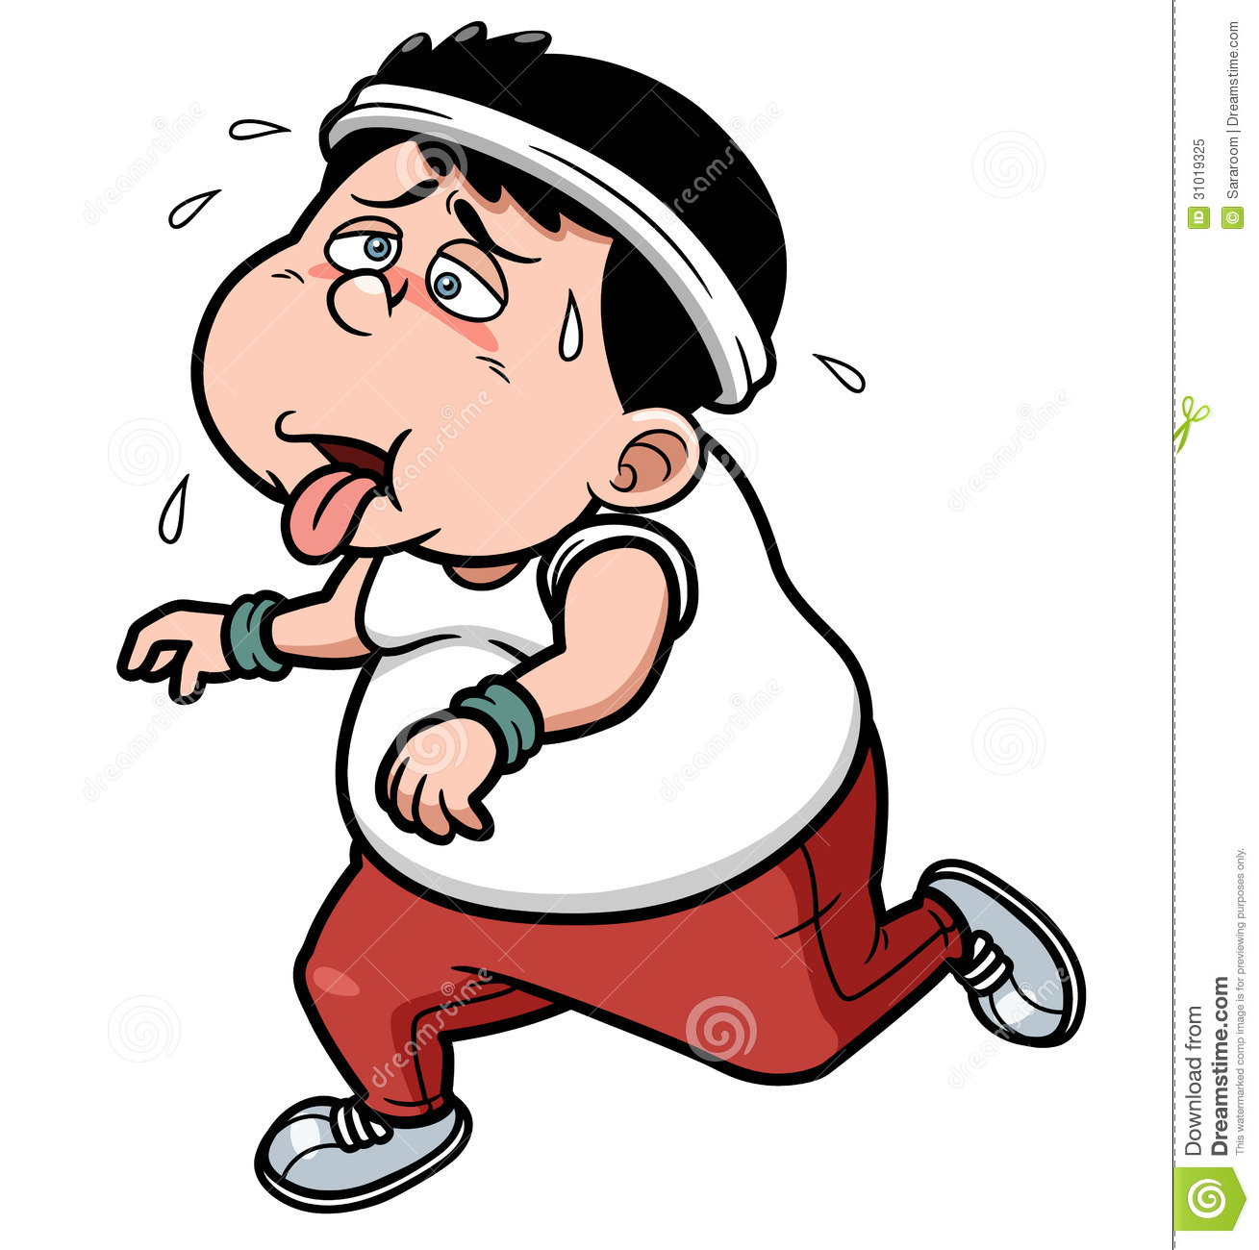
Background
New Study Finds 73% Of People Who Set Fitness Goals As New Year's Resolutions Give Them Up(Dr Beradi,2013)
A new exercise partner is the key to exercising more (Rackow,2015)
Reasons for quitting :
Lack of motivation
No accountability
Wanting to see instant results
Not enjoying the process

Slide 4

Aim
Create a social network that connects a person to other exercise companions who are at the same level as him as her.
By same level we mean physical ability for example, people who can only walking will be linked together.
For those that are more physically capable an algorithm will connect them together using certain measures of their physical ability that are generally accepted to measure physical ability, for example, the number of push-ups a person can make in 60 sec.

Slide 5

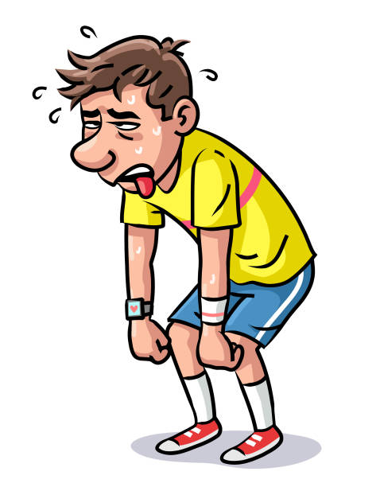


I quit

Slide 6


People Grouped accordingly

Slide 7

Solution -> Graph based data structure
New user

Slide 8
How are the edges connected
We are looking for the most compatible companions for our users.
We quantify their physical ability by calculating a weighted average in order of how important a measure is to our calculation.
Physical Ability= (bmi * (0.3) + cooperTest * (0.25) + plank * (0.05) + gymFrequency * (0.2) + numberOfpushups * (0.2))
This gives us the weight of User/Profile

Slide 9
This weight is then compared to other users in the network.
Users are connected if the DIFFERENCE OF THEIR WEIGHTS IS LESS THAT 20.
These are then considered compatible companions
The strength of compatibility/cost of edge is the equal the difference

Slide 10


Slide 11
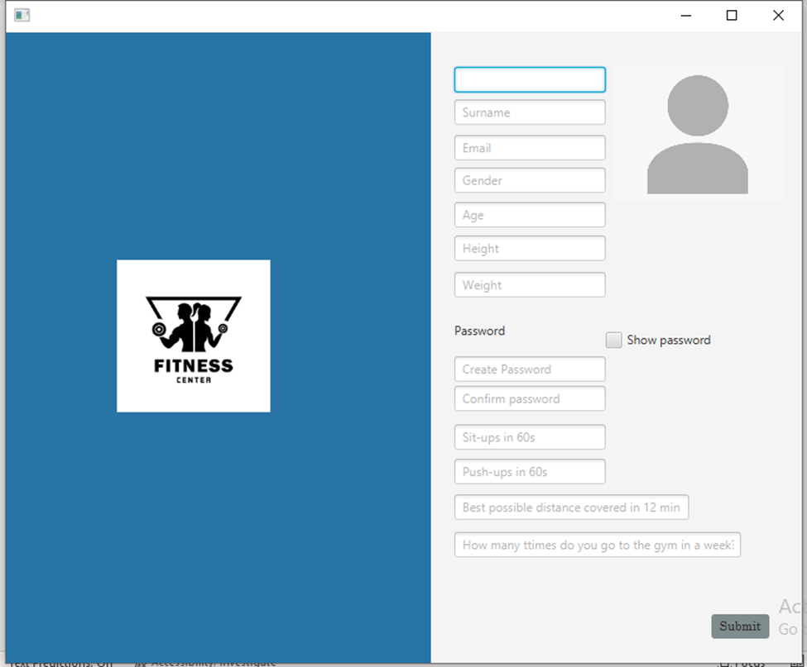

Slide 12
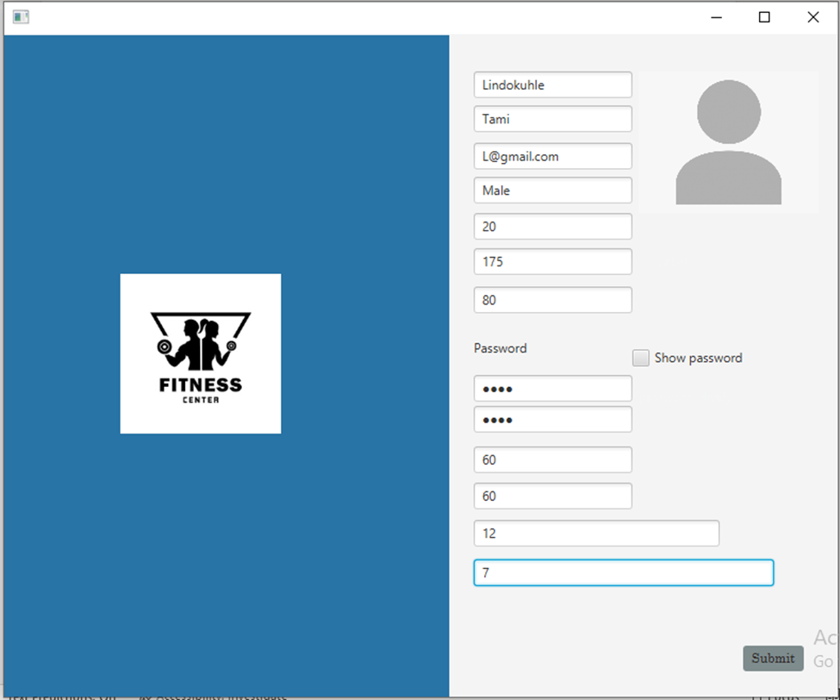

Slide 13
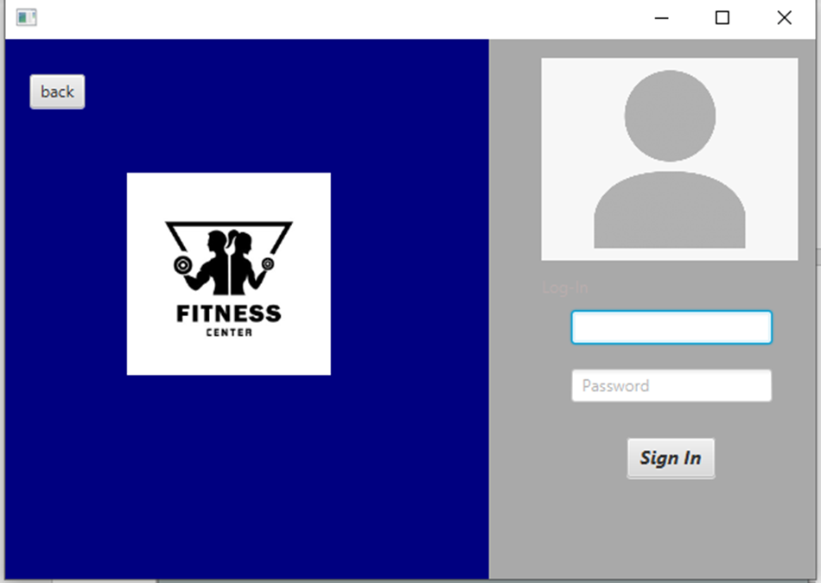

Slide 14
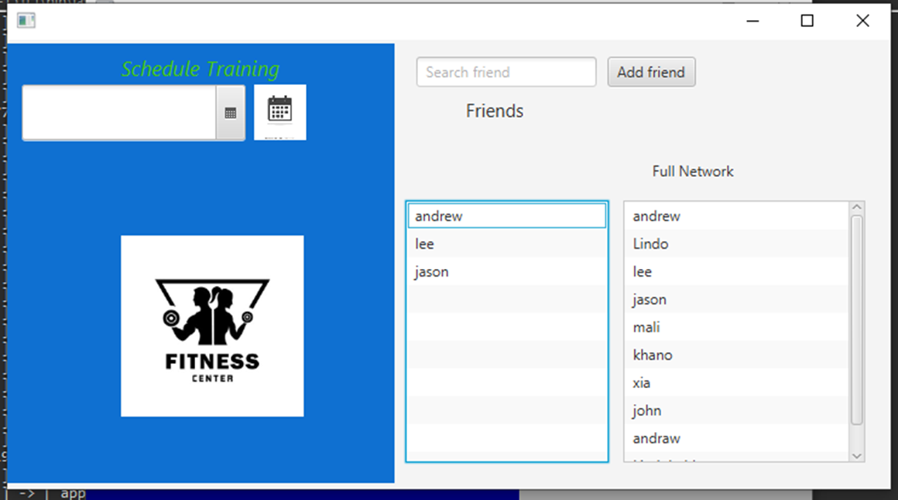

Slide 15
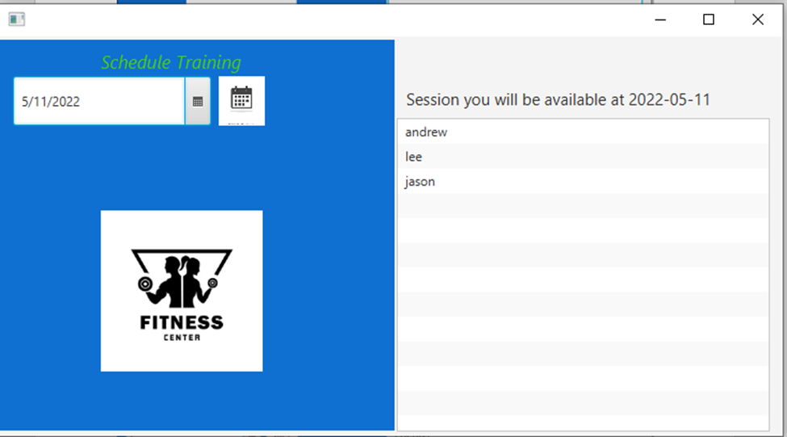

Slide 16
References
Interactive, H., New Study Finds 73% Of People Who Set Fitness Goals As New Year’s Resolutions Give Them Up–Bodybuilding. com. Bodybuilding. com.
Pamela Rackow, Urte Scholz, Rainer Hornung. Received social support and exercising: An intervention study to test the enabling hypothesis. British Journal of Health Psychology, 2015; 20 (4)

